Slide 1

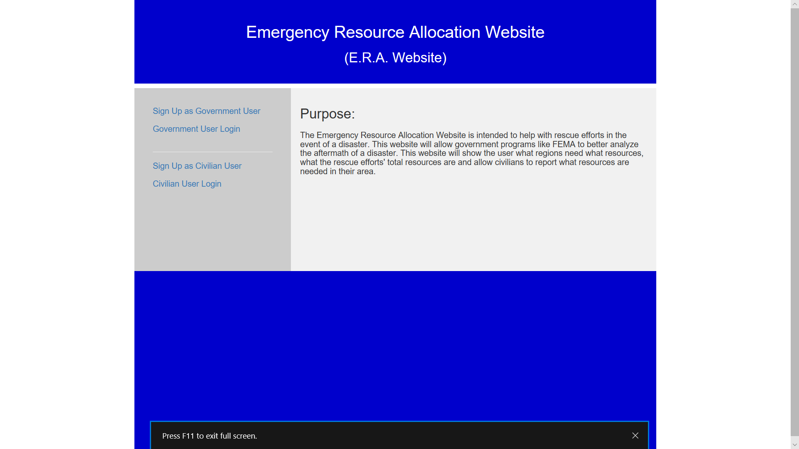
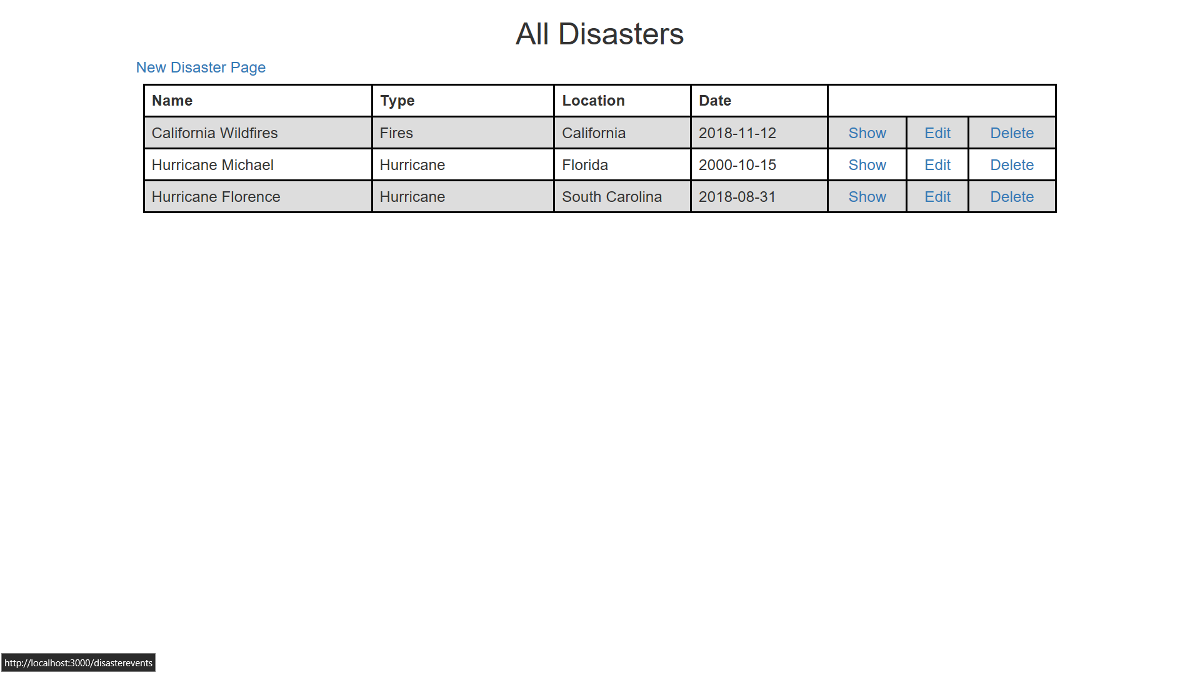
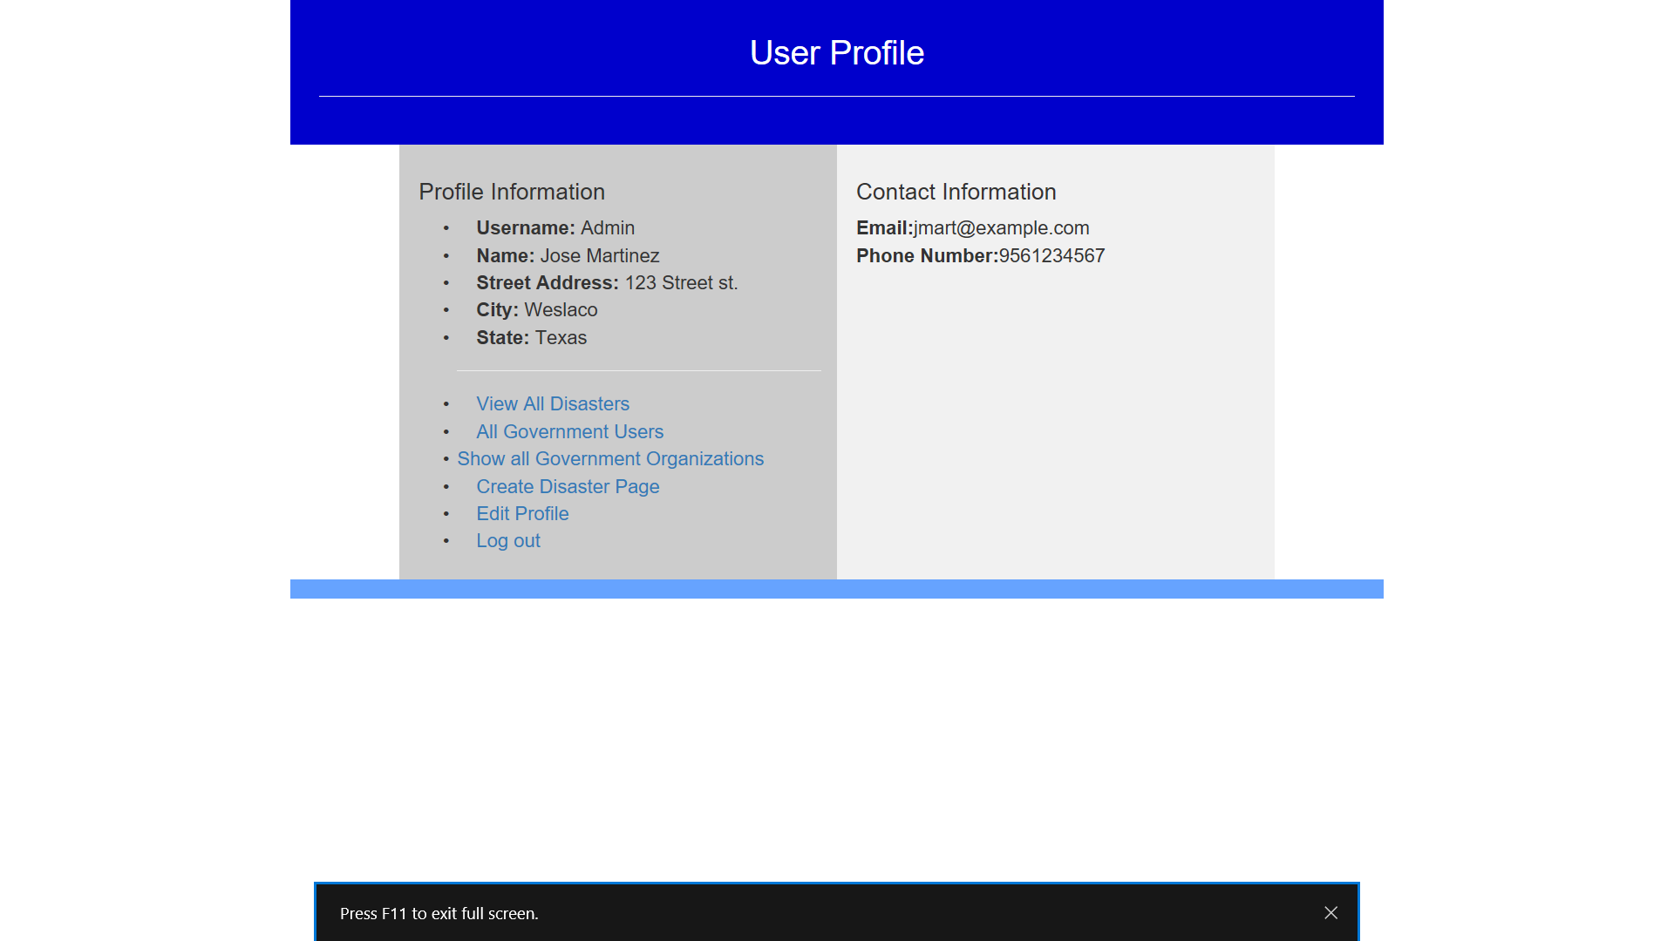
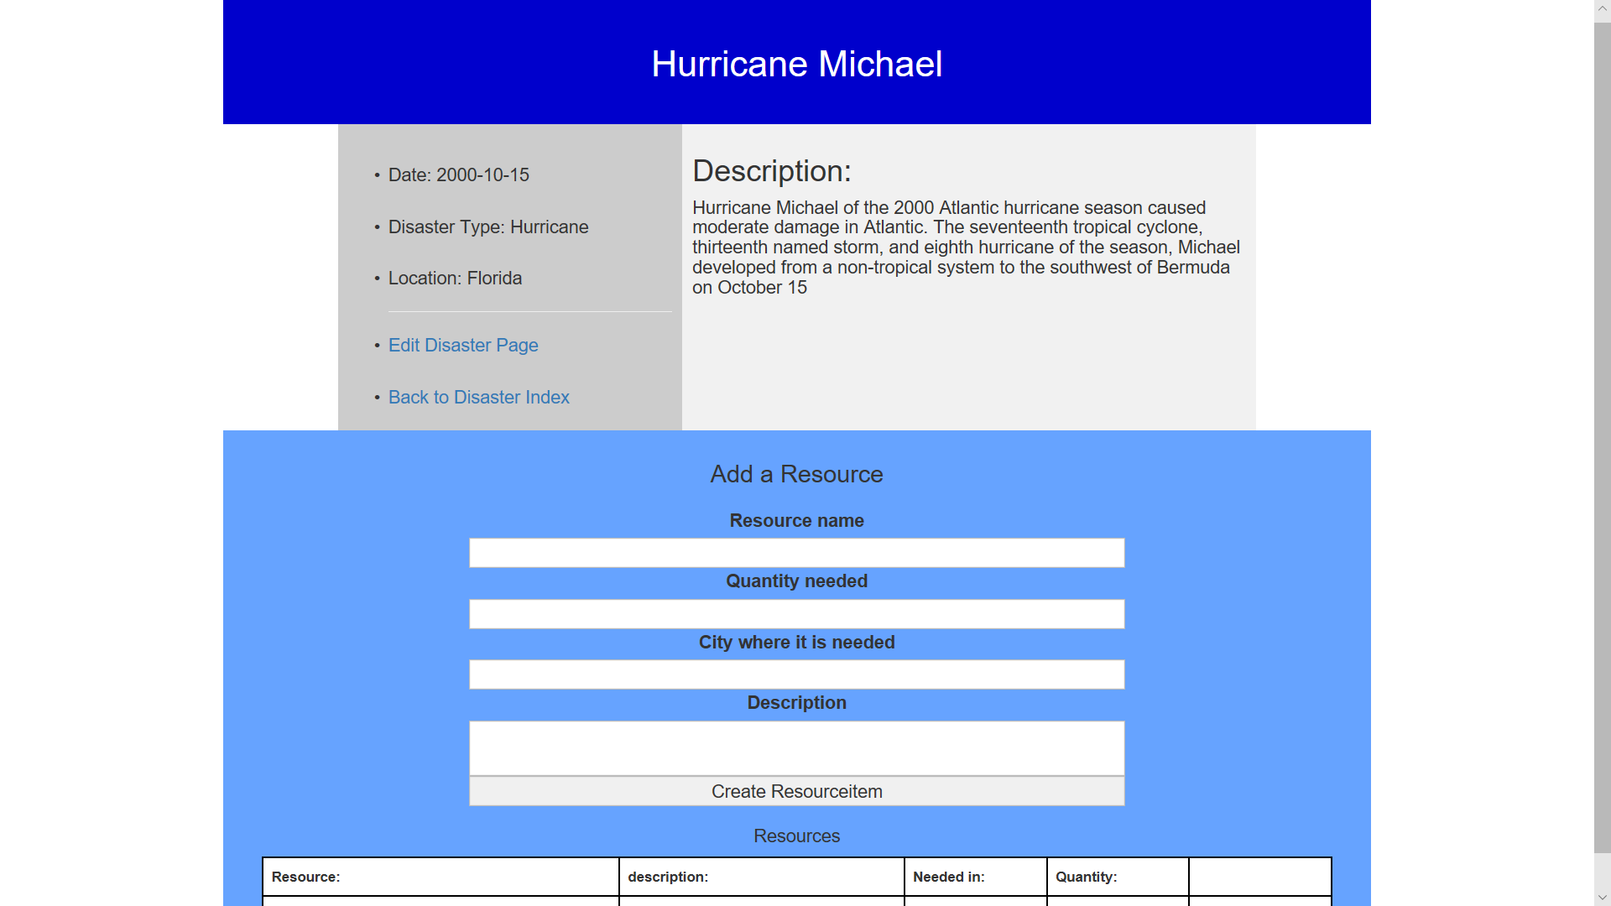
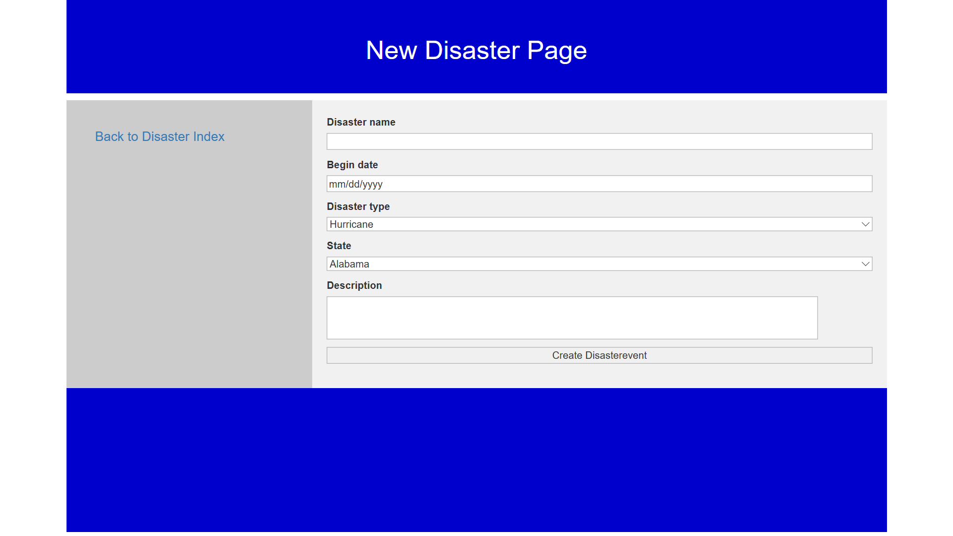

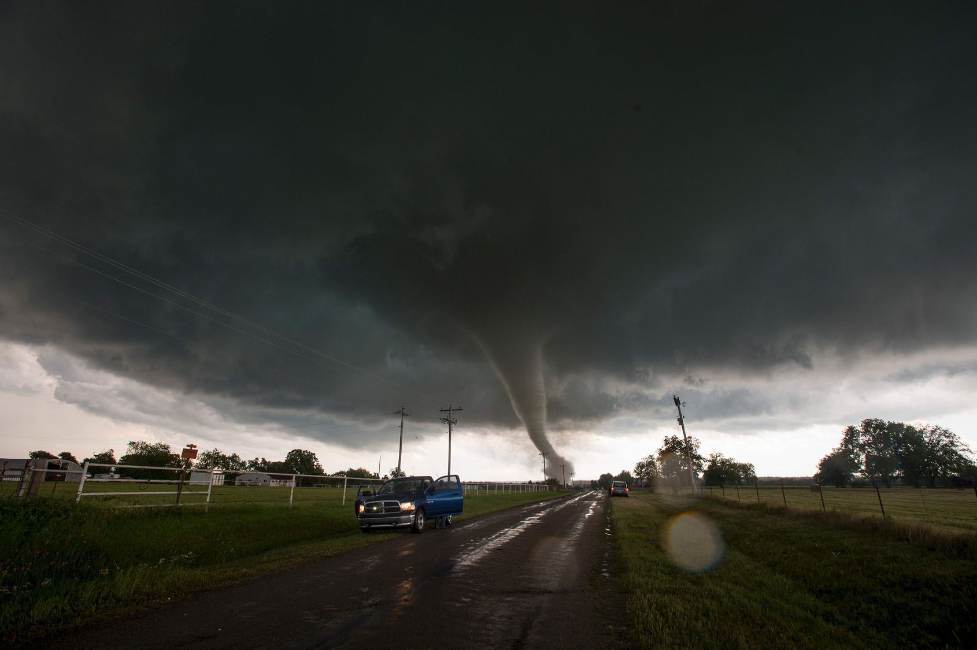
Emergency Resource Allocation (E.R.A.) Website
Conclusion:
Jose Martinez
Advisor: Dr. Emmett Tomai
University of Texas Rio Grande Valley
Knowing where to send resources allows a more efficient allocation of resources.
If even one life is saved because they got the food or medicine they needed in time because of this project, then it will have been a success. Rails has features that aided in the development of this webpage and I believe using a full stack frame work was a wise choice.
Abstract:
This poster describes the creation of a website intended to
provide government organizations with a more organized view of needed resources during a natural disaster and
Allow civilians to quickly report what resources they need and where they need them
Future Additions
Admin Profile page
Future possibilities for this project may involve
implementation of google maps to improve the location of resource need accuracy
the prediction of which resources will be needed once a disaster has been declared
predictions would use the maps data to determine possible quantities of resources while data from previous disasters can help determine which items will be needed.
Clicking show leads to this page
All users can view this page but only Admin and Govt. level users can edit and delete
These are Admin specific actions.
They are similar to the “View All Disasters” page, but with different columns
These are Admin specific actions.
They are similar to the “View All Disasters” vpage
The resource and disaster databases are relational databases, every disaster can have many resources
Clicking this link allows a government or Admin user to create a new Disaster page
Helpful References
A webpage that will guide the user through a blog webpage setup:
https://guides.rubyonrails.org/getting_started.html#installing-rails
A free online book that covers a Ruby on Rails tutorial in great detail can be found by searching for: Learn Web Development with Rails
Civilians report the resources they need, which are then seen by government officials so they know where resources are needed.
When a request is sent the civilians location is also sent, this being the location they set in their profile
Government officials can satisfy and then delete requests via a page similar to the one above
This allows a govt user – civil user interaction.
Why did I use Ruby on Rails?
Ruby is the object oriented programming language used for this project
Rails is a full stack framework
Ruby is easy to learn with intuitive commands
Rails has a large library that provides helpful gems for making development quick and easy
Ruby on Rails is also used by websites like:
Airbnb
Twitch
Shopify
gitHub

